Slide 1

Team farachat
HUMAN
FACTORS
BENZMANE Asmaa
BOUCHOUAL Imane
ESSAKHI Zineb
PRESENTED BY:

Slide 2
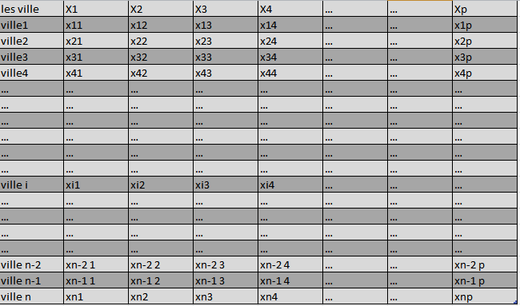
Identifying:
1- Patterns between human activity’s and
COVID-19
2- Efficient factors to predict hotspots.
Our Mission
First Step:
Define a Data-base of all supposed factors that could help predicting hotspots, including human activity’s factors.
Using our Algorithm of machine learning (see Algorithm 2 ) that use history of COVID-19 since 2019 to select most efficient factors and delete the others
Updating our Data-base (letting only the most efficient factors)

Slide 3
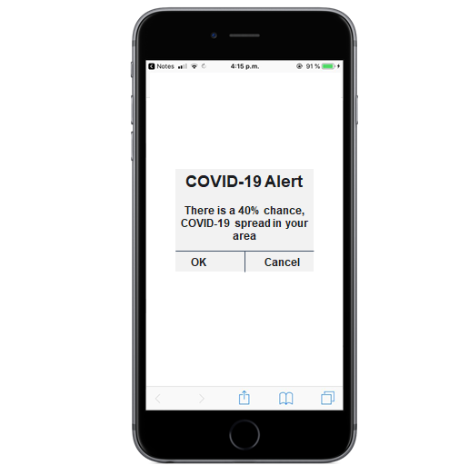
The App will send COVID-19 Alerts to each user in case of predicting a future possible Hotspots in his area using algorithm 2 of prediction (See Algorithm 2 )
Second step:
Create an interactive App(Name of the App: COVID-19 Heroes) to evaluate and develop our Data-base through the experience of our users.
“COVID-19 Heroes” is a Win-Win App :

Slide 4
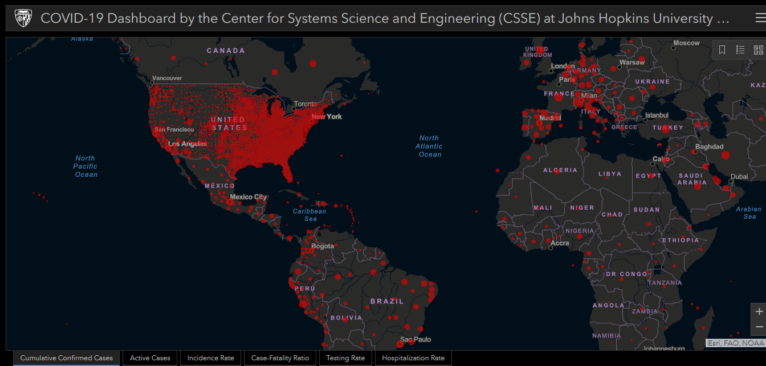
Our App use localization Data of users and COVID-19 Dashboard by the Center for Systems Science and Engineering (CSSE) at Johns Hopkins University (JHU) to detect users in Hotspots Regions.
Link: https://www.arcgis.com/apps/opsdashboard/index.html#/bda7594740fd40299423467b48e9ecf6

Slide 5
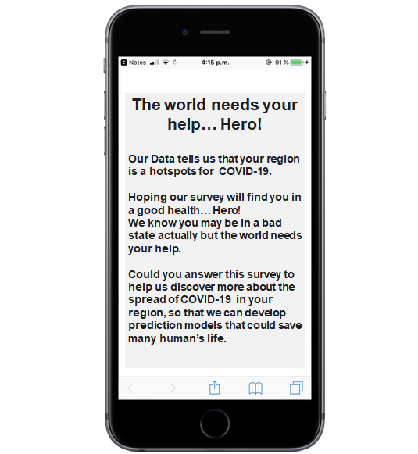
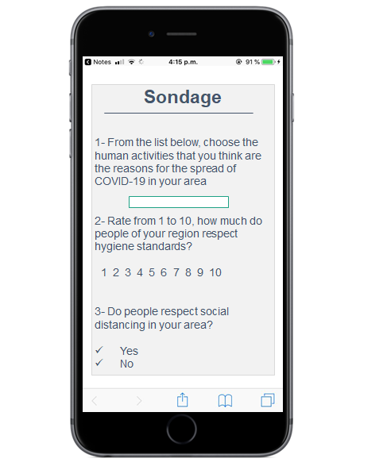
Then the App send survey to them.
The user should answer surveys sending by the App if he wants to keep receiving alerts in case of risk. Surveys help us to understand more deeply the impact of human activities and behavior on COVID-19 spread, which will help to develop our Data-base and then having more efficient algorithm (the advantage of our application is that the database used in algorithm 2 will be updated until the end of COVID-19) So that we will have most efficient and realistic factors

